Slide 1
A guide to narrative writing
8/1/19

Slide 2
What is a narrative?
Tells a story
MOST of the time it is categorized as fiction.
What is the difference between fiction and non-fiction?
What would be an example of non-fiction that is also narrative?
Must include the following:
Characters
Plot
Conflict
Setting
Dialogue
Imagery
Point of View

Slide 3
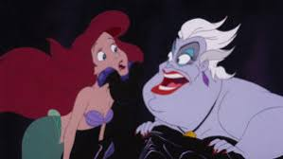
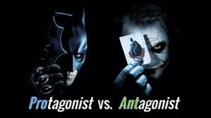
characters
Who is the protagonist?
Who is the antagonist?
Make sure if you mention a character they are an indispensable element to the plot.
What to consider:
How do the characters relate to one another?
How do the characters react to certain events in the story?
What sets them apart from other characters?

Slide 4
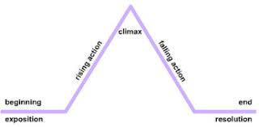
plot
Think of it as the sequence of events.
It will most likely consist of:
Background information
Conflict
Climax
Conclusion
What to consider:
Do the readers need to know what I am writing to understand the plot as a whole?

Slide 5
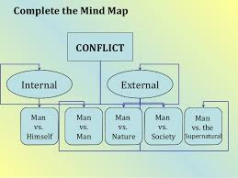
conflict
Two types:
Internal- man vs. self
External- Man vs. Man, man vs. society, man vs. nature, man vs. technology
What to consider:
What is the defining conflict in my story?
What happened because of this conflict?

Slide 6
setting
When and where the story takes place
What to consider:
How does the setting affect the events and the actions of the characters?

Slide 7
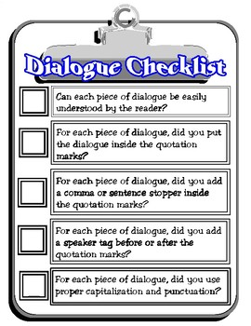
dialogue
Conversation between two or more people
What to consider:
Did I put my dialogue in-between quotation marks?
Is my dialogue properly formatted
For example:
Mrs. Montgomery exclaimed, “Mrs. Bell, what are you doing?!”
“What does it look like?” Mrs. Bell retorted.

Slide 8
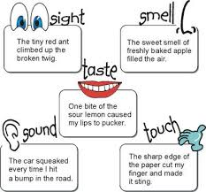
imagery
Descriptive language
What to consider:
Does the language you’re using help the reader to visualize, smell, hear, feel, or taste what you are trying to describe?

Slide 9
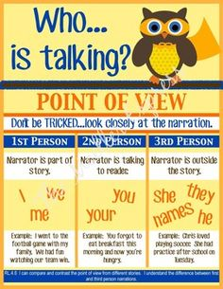
Point of view
First person- I, My, We, Our
Second person- You
Third person- He, she it
What to consider:
From what POV is my narrative being told?
99% of the time it will be first person.

Slide 10
Your assignment
Compose a one page narrative essay describing the best day of your life. Be sure to include the various elements of narrative writing that we have discussed.
I ALWAYS prefer that writing assignments be typed. If this is absolutely not possible, you may write it, but please make sure you don’t rush. If I can’t read it, you will receive a zero.
If you type it, you may double space, but do not use anything larger than 12 pt font.
Do not double space if you are handwriting.
Remember to use an MLA heading.
Your name
Teacher’s name
Class
Date
I’ll share my example first

