Slide 1
American Literature Vocabulary
Unit 11

Slide 2
How this works...
You will have a mini-quiz and a test on these same 10 words
Your mini-quiz will be Friday, your test will be next Friday
Be sure to write down the word, definition, and part of speech!

Slide 3
Censurable – adj.
deserving of blame or correction
reprehensible
Antonyms:
commendable
meritorious

Slide 4
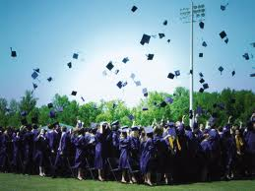
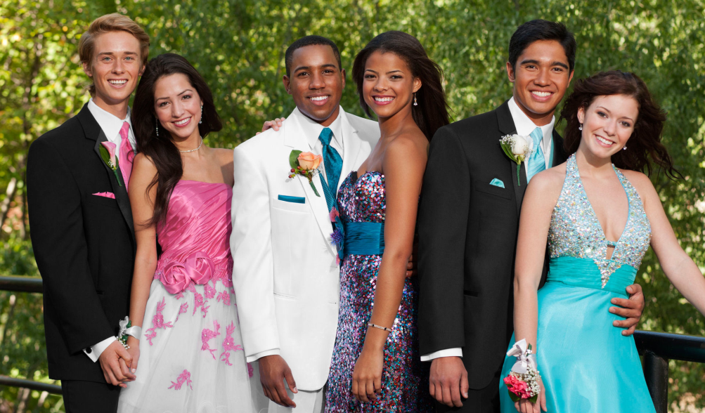
Contingent-adj.
likely, but not certain to happen
happening by chance
conditional
Antonyms:
certain
independent of

Slide 5
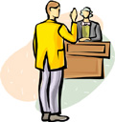
Corroborate-v.
to confirm
to verify
Antonyms:
contradict
discredit

Slide 6
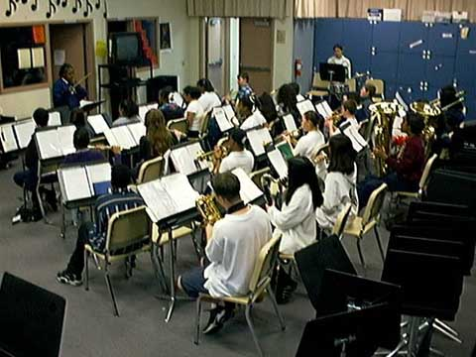
Denizen –n.
an inhabitant
a resident
a dweller
Antonyms:
alien
stranger
foreigner

Slide 7
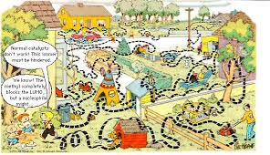
Discursive-adj.
rambling
wandering
nomadic
Antonyms:
short and to the point

Slide 8
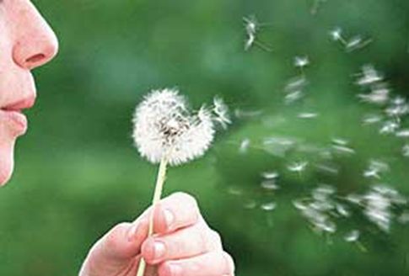
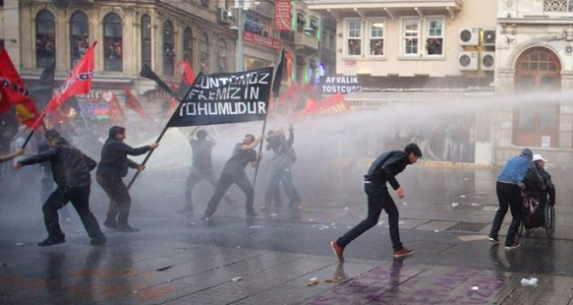
Disseminate-v.
to scatter or spread widely
disperse
broadcast
Antonyms:
bring together
concentrate

Slide 9
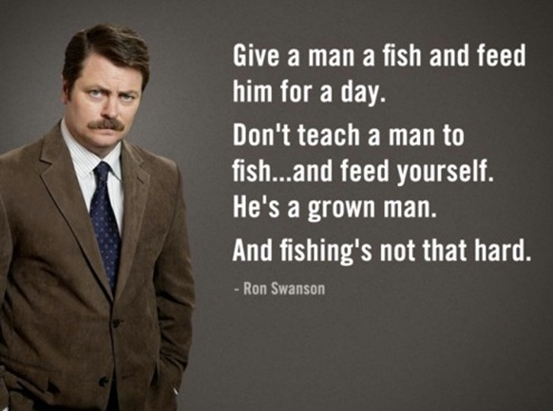
Gauche-adj.
awkward
lacking in social graces
tactless
clumsy
inept
Antonyms:
tactful
diplomatic

Slide 10
Inculcate-v.
to impress on the mind by repetition
to ingrain
Antonyms:
efface
root out

Slide 11
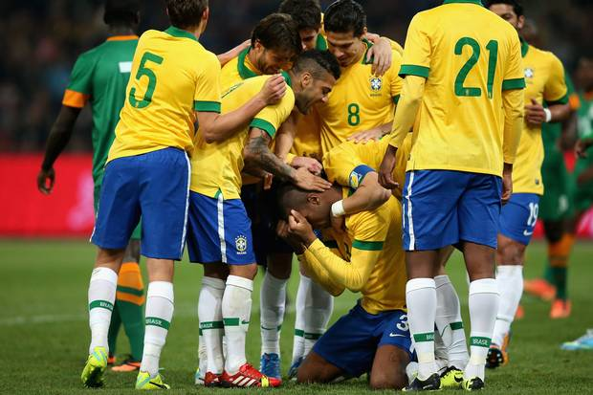
Palpable-adj.
capable of being touched or felt
easily seen, heard, or recognized
tangible
Antonyms:
intangible

Slide 12
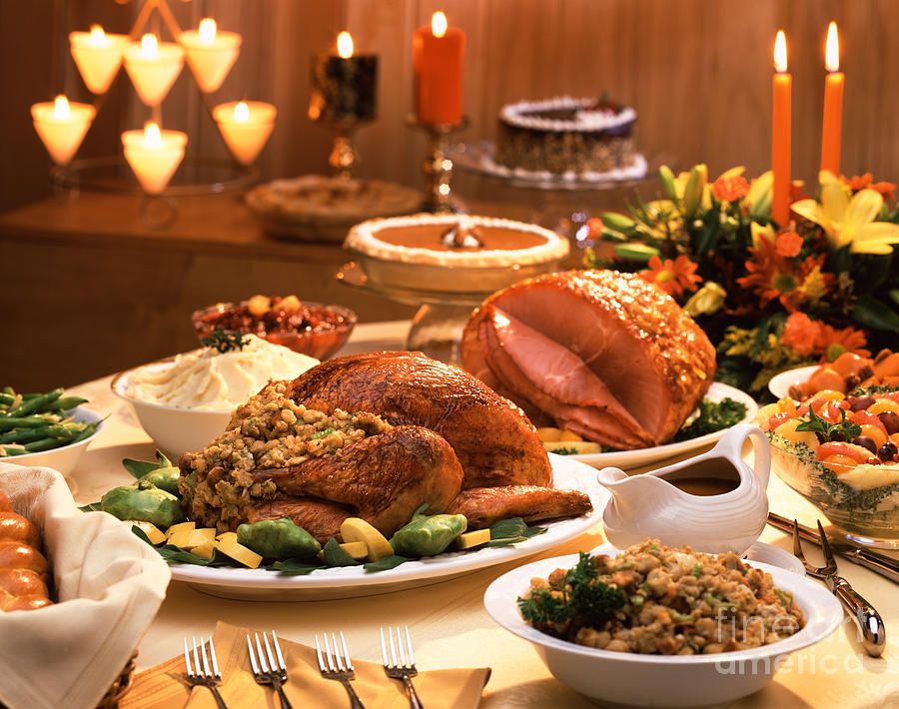
Satiate-v.
to satisfy completely (v.)
gorge
full, satisfied (adj.)
Antonyms:
deprive entirely of

